Slide 1
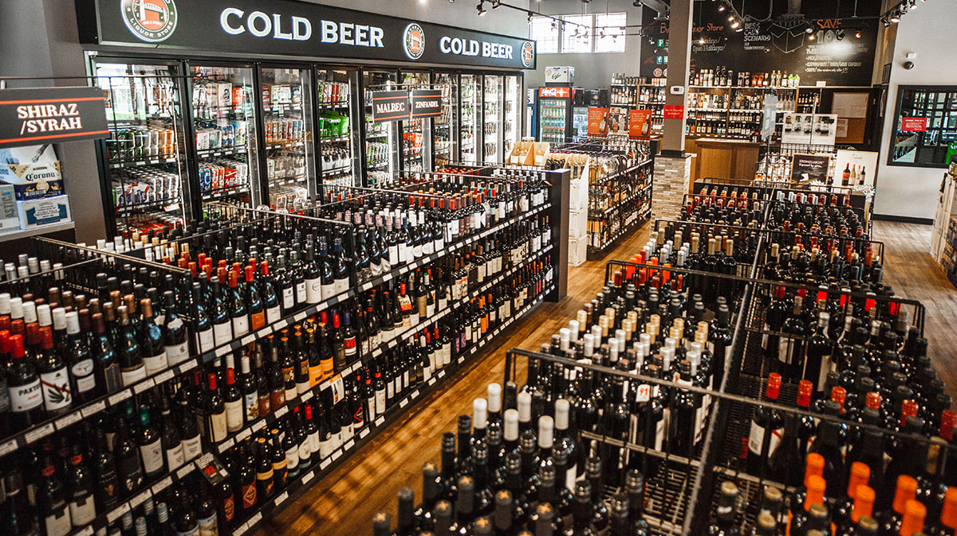
Defining the best place to install a liquor store

Slide 2
Performing a data-driven analysis to find the best place to set up a business is very valuable to an entrepreneur
Setting up a business is a great challenge that involves not only an investment but a life decision.
The best location to carry it out was studied in the Las Condes commune in Santiago de Chile.
Chileans have the custom of going out to eat and then continuing the party either at home or in discos,
especially on Thursday, Friday and Saturday.
Define the best place to help stakeholders make the best decision.

Slide 3
Data acquisition and cleaning
Factors that will influence our decission
number of existing restaurants within a radius of 800 meters from the predefined center of the neighborhood (any type of restaurant)
number of liquor points of sale (bars, supermarkets, liquor stores, among others) in the same distance range
Data sources that will be needed to extract/generate the required information:
The center of each zone will be determined based on the sectorization proposed by the Las Condes mayor's office and the coordinates were obtained through the page https://www.mapcoordinates.net/es
number of restaurants and their type and location in every neighborhood will be obtained using Foursquare API
The number of bars, alcohol outlets and their location in each neighborhood will be obtained using Foursquare API

Slide 4
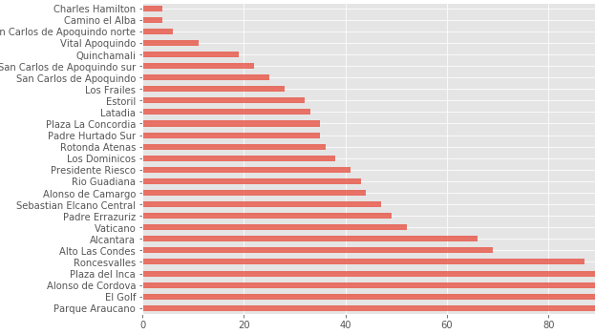
Venues found by Foursquare on each neighborhood

Slide 5
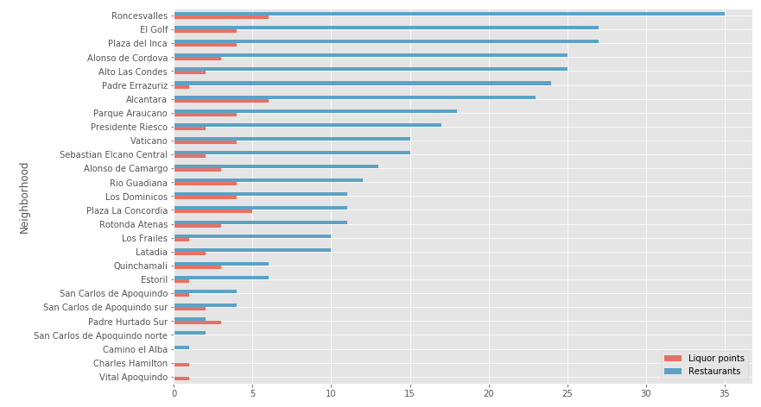
Liquor outlets and restaurants on each neighborhood

Slide 6
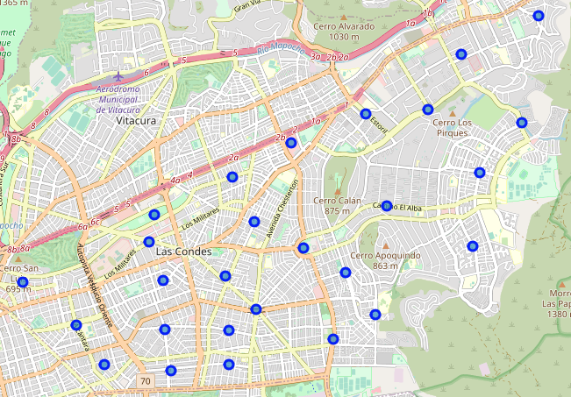
The 26 initial neighborhoods that are part of the analysis

Slide 7
Clustering
K-means algorithm
It was iterated over different values of k
k = 6 proved to be the most appropriate number

Slide 8
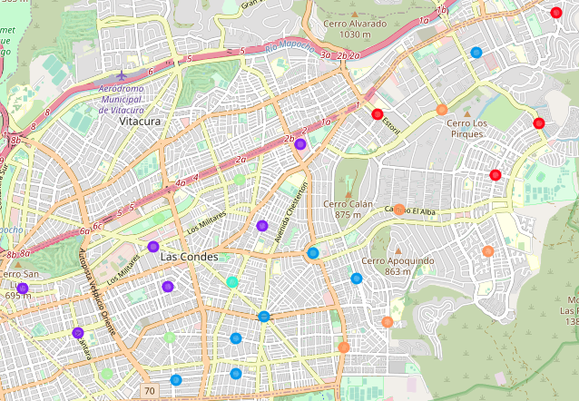
Result of clustering

Slide 9

New indicator: percentage ratio
$$R_{\%}=\frac{N_{liquor}}{N_{liquor}+N_{restaurants}}$$
$R_{\%}$: Percentage Ratio
$N_{liquor}$: number of nearby liquor stores, bars, supermarkets or alcohol outlets
$N_{restaurants}$: number of nearby restaurants

Slide 10
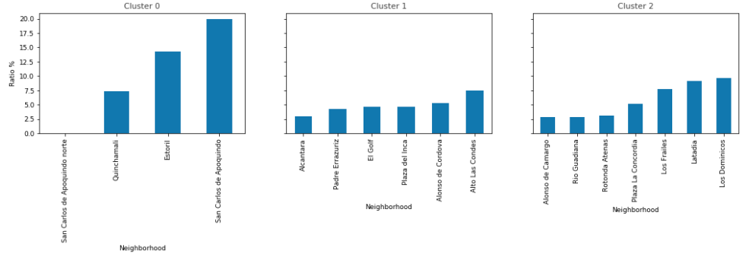
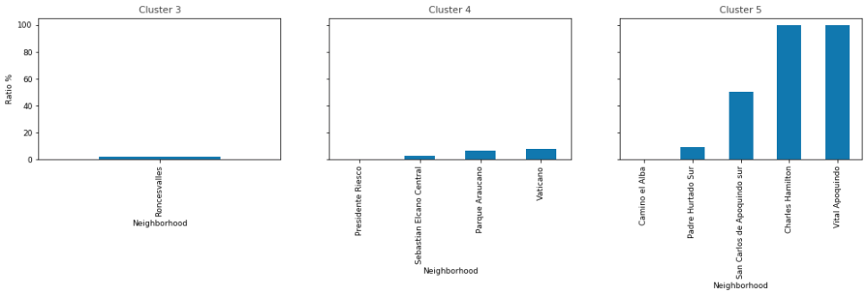
Percentage ratio of neighborhoods for each cluster
Low ratios are preferred to encourage consumption by customers leaving restaurants
Clusters 1, 3 and 4 are best suited for in-depth analysis

Slide 11
Results
Neighborhoods were filtered keeping only those with a ratio less than or equal to 10%
Using a joint heat map to define better neighborhoods
Trade-off between high number of people and high competition for clients
The best neighborhoods are those that have a ratio lower than 10% and fall on green areas of the heat map
In addition, they are located in the vicinity of the main axis of the commune, Apoquindo avenue, and line 1 of the metro

Slide 12
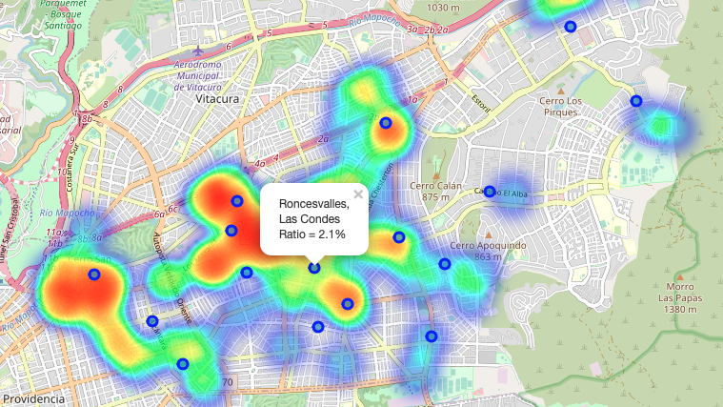

Slide 13
Selected neighborhoods
Neighborhood | Cluster | Ratio
Alcántara | 1 | 3.0 %
Vaticano | 4 | 7.6 %
Plaza del Inca | 1 | 4.6 %
Roncesvalles | 3 | 2.1 %
Río Guadiana | 2 | 9.0 %

Slide 14
Future directions of analysis
Accuracy of the models and clusterization has room for improvement.
Capture more neighborhood attributes such as buildings, demographic and socioeconomic characteristics, distances, accessibility, land use, etc.

